Slide 1
Branchy-GNN: A Device-Edge Co-Inference Framework for Efficient Point Cloud Processing
J. Shao, H. Zhang, Y. Mao and J. Zhang, "Branchy-GNN: A Device-Edge Co-Inference Framework for Efficient Point Cloud Processing," ICASSP 2021 - 2021 IEEE International Conference on Acoustics, Speech and Signal Processing (ICASSP), 2021, pp. 8488-8492
Advisor: Dr. Chih-Yu Wang
Presenter: Shao-Heng Chen
Date: March 23, 2022
Notes:
2021年6月投稿於IEEE ICASSP會議的論文

Slide 2
Outline
1. Overview
2. Branchy-GNN framework
3. Cost-Overhead Tradeoff
4. Experiments
5. Future works
1

Slide 3
Overview
1. GNN vs. 3D-CNN?
– Input: Point Set vs. Dense Array
– Operation: PointNet vs. Convolution
– Neighbor: varying # points vs. fixed # pixel
2. Why not model splitting?
– more severe data amplification effect
3. What’s the possible challenges?
– data amplification, autoencoder/JSCC design
2
Notes:
0. Lidar scanner 光達, Stereo camera 3D 攝影機於 自駕車、3D列印、消費電子(人臉辨識) 提供3D資料處理、特徵提取的需求
GNN 處理 point cloud raw data 而3D CNN 得先把點雲轉成3D grid 再去做 3D 捲積
2. 直接切模型的inference不一定會比較快 因為data amplification effect 中間的intermediate feature會比raw data還大
3. DNN-based 方法 不一定能直接套用
直接建一個graph的autoencoder蠻困難的 GAE也只能處理小的圖(order of ten)
把graph直接餵給JSCC也不是個好方法 會影響adjacency matrix的graph相依性 嚴重影響重建的品質

Slide 4
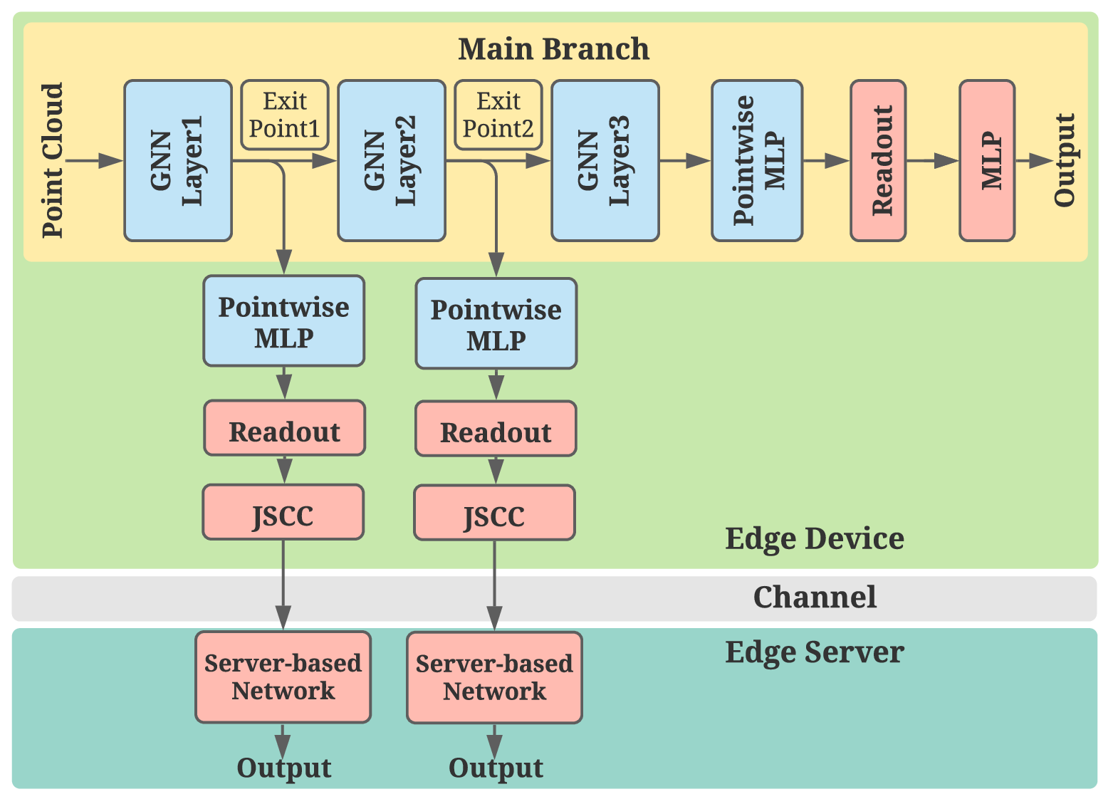
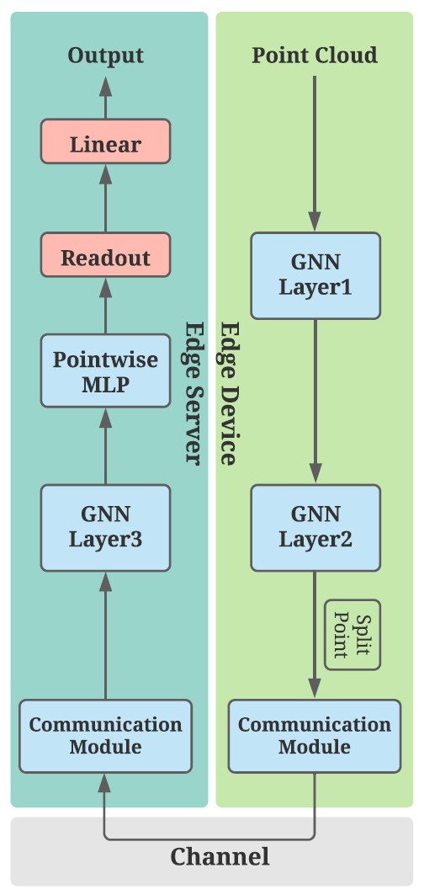
Branchy-GNN framework
– Branch structure reduce computational cost
– JSCC coding scheme reduce comm. overhead
3
Notes:
Two considerations, branch structure and coding scheme
On device, (1) pointwise MLP, (2) readout layer , (3) JSCC module
On server, server-based network

Slide 5
Branchy-GNN framework
A point-wise MLP [1]
(2) A readout layer
(3) A Joint Source-Channel Coding
(JSCC) module
(4) A server-based network
[1] C.R. Qi, H. Su, K. Mo, and L.J. Guibas, “Pointnet: Deep learning on point sets for 3d classification and segmentation,” in Proceedings of the IEEE Conference on Computer Vision and Pattern Recognition, 2017, pp. 652– 660
4
Notes:
(1)輕量MLP來提取特徵，用於減少訓練參數，實現類似CNN權重共享機制，本質是用[1,1]大小的捲積核去做卷積操作，所以算力需求較低
(3)JSCC是輕量autoencoder 把feature values映射到channel symbol 並透過加入幾層non-trainable layer來模擬comm. channel
(4) server-based network 就是幾層NN / fc layer

Slide 6


Branchy-GNN framework
(2) A readout layer [2]
$readout function$
$s=\frac{1}{N}\sum_{i=1}^{N}{x_{i}}||max_{i=1}^{N}x_{i}$
$x_{i} feature vector of the i^{th} point$
$N number of nodes$
$||$ $concatenation$
[2] Y. Wang, Y. Sun, Z. Liu, S.E. Sarma, M.M. Bronstein, and J.M. Solomon, “Dynamic graph cnn for learning on point clouds,” ACM Transactions On Graphics, vol. 38, no. 5, pp. 1–12, 2019
5
Notes:
(2)讀出層 把point cloud 映射到一個固定大小的陣列

Slide 7
Computation Cost-Overhead Tradeoff
– On-device computation latency vs. communication latency
– Computational cost determined by main branch GNN layers
– Communication overhead determined by JSCC output dimension
– Earlier exit means less on-device computation and higher
communication overhead
6

Slide 8
Training Methodologies
– Complete training may cause slow convergence
(1) Separate training, first train the original GNN / main branch
(2) Then, fix the weights and train the multiple branches
7
Notes:
Complete training may encounter slow convergence

Slide 9
Experimental settings[2]
– Shape recognition on ModelNet40 [3], 40 categories of 12311 images
– Main branch: DGCNN [2]
– AWGN channel with SNR = 20dB
– Edge device: Raspberry Pi3
– Edge Server: PC with RTX 2080Ti
[3] Z. Wu, S. Song, A. Khosla, F. Yu, L. Zhang, X. Tang, and J. Xiao, “3d shapenets: A deep representation for volumetric shapes,” in Proceedings of the IEEE Conference on Computer Vision and Pattern Recognition, 2015, pp. 1912–1920.
[2] Y. Wang, Y. Sun, Z. Liu, S.E. Sarma, M.M. Bronstein, and J.M. Solomon, “Dynamic Graph CNN for learning on point clouds,” Acm Transactions On Graphics, vol. 38, no. 5, pp. 1–12, 2019
8
Notes:
ModelNet40包含40類的12311個三維形狀
通道雜訊 是常態分布的 AWGN channel. JSCC encoder 的輸出會基於l2 norm去正規化
SNR = P / (var)^2 (dB) 平均signal power P 設為1 又若channel noise 設 0.1 代表 SNR = 20 dB

Slide 10
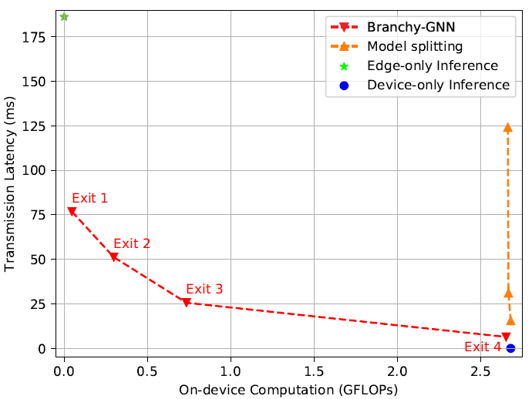

Experimental results
– On-device computational cost vs. communication overhead
– channel BW = 10kHz (optimal)
– baselines: (1) device-only,
(2) edge-only,
(3) model splitting
– input size: 512 (points)
– output size: 1536, 1024, 512, 128
$Fig. 2.On−device computation cost$
$and communication latency$
9

Slide 11
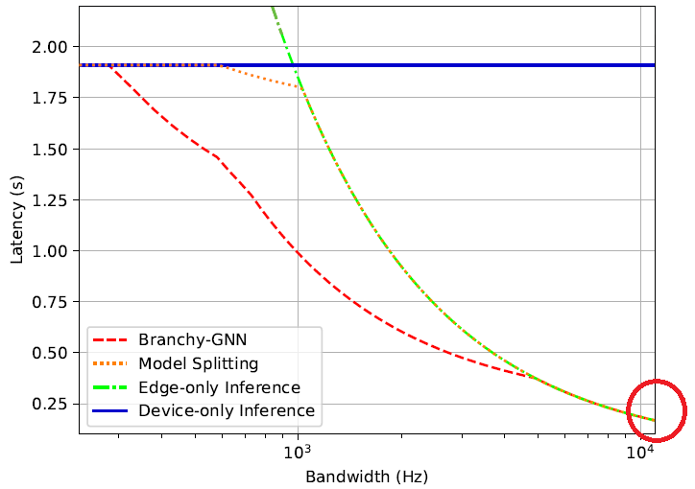

Experimental results
– End-to-end inference latency
– meets min. edge inference latency
with limited BW (0.3 ~ 5 kHz)
optimal
$Fig. 3.Edge inference latency$
$in different bandwidth$
10

Slide 12
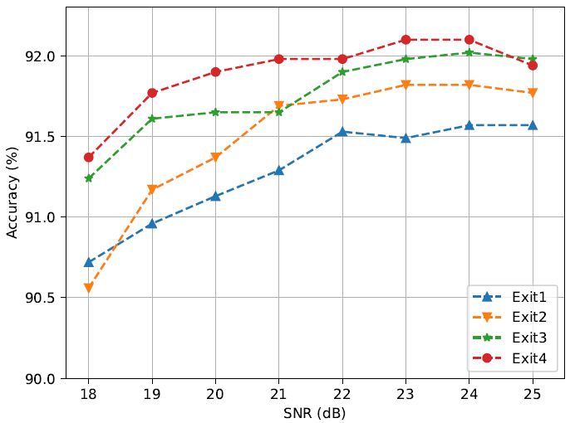

Experimental results
– Verify robustness: train at SNR = 20 dB, test at SNR = 18~25 dB
– input size: 512 (points)
– output size: 1536, 1024, 512, 128
$Fig. 4.Classification accuracy under$
$different channel conditions$
11

Slide 13
Future Works
– Maybe try some of the ideas on YOLO_CFAR case
12

Slide 14
Appendix A. GNN-based point cloud processing
– types
(1) Recurrent Graph NN
(2) Convolutional Graph NN
(3) Graph Autoencoders
(4) Spatial-temporal Graph NN
13

